Slide 1
Reinforcement Learning
Lecture
5 & 6 & 7
Woong won, Lee

Slide 2
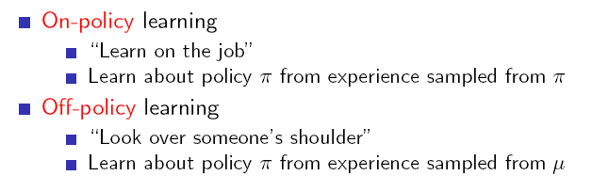
Review Lecture 5
Model-free control
Model free = unknown MDP
Control = evaluate(value function) + improvement(policy)
Off-policy learning → Q-learning!!

Slide 3
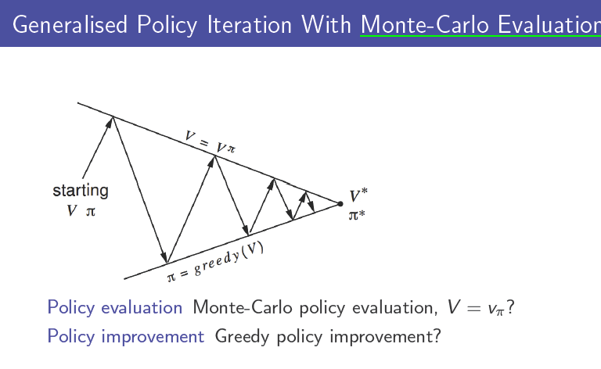
Review Lecture 5
two problems
1. Greedy → exploration X
- if you act greedily all the time, you don't garentee the trajectories that you following explore entire state space
2. if use value function, how
can you model free? -->
action-value function

Slide 4
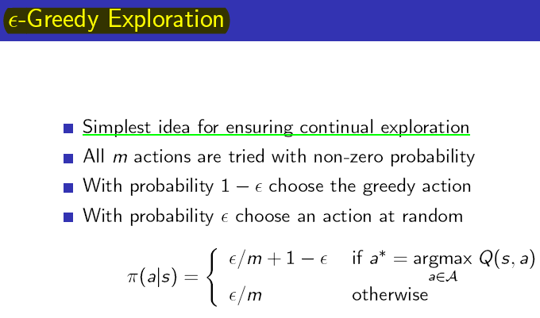
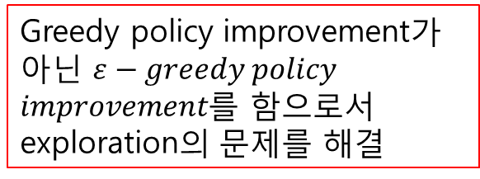
Review Lecture 5
Greedy policy improvement가 아닌 $ε−greedy policy$
$improvement$를 함으로서 exploration의 문제를 해결

Slide 5
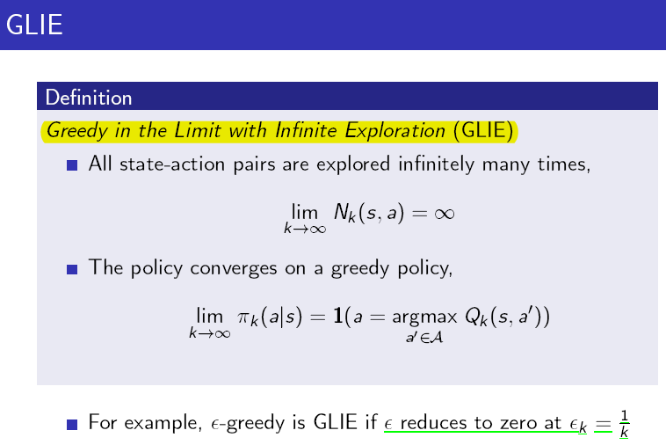
Review Lecture 5
결국 우리가 원하는 건
Deterministic policy이므로
이와 같이 GLIE하게 만들어준다

Slide 6
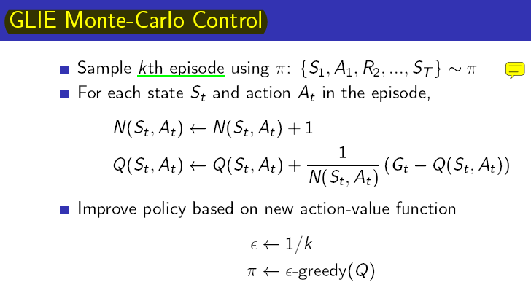
Review Lecture 5
Sampling
Update Q – values
Improve policy

Slide 7
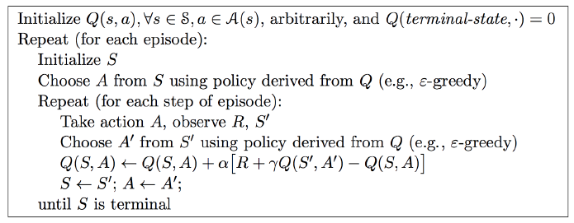
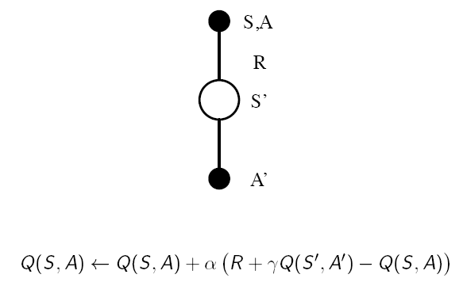
Review Lecture 5
MC Control → TD Control (Lower variance, online(바로바로 improve), Imcomplete sequence
SARSA 하나마다 Q value를 update!
Sampling
Update Q – values
Improve policy
MC와의 차이점은 2번!

Slide 8
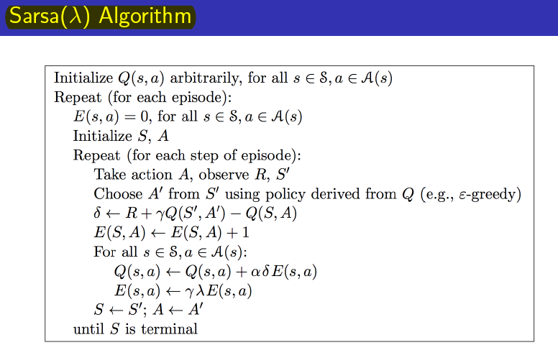
Review Lecture 5
TD Control
SARSA
n-step SARSA
Forward-view SARSA(λ)
Backward-view SARSA(λ)
Eligiblity traces는 헷갈리니 한 번 더 볼 것
Backward-view는 곧 Eligiblity traces

Slide 9
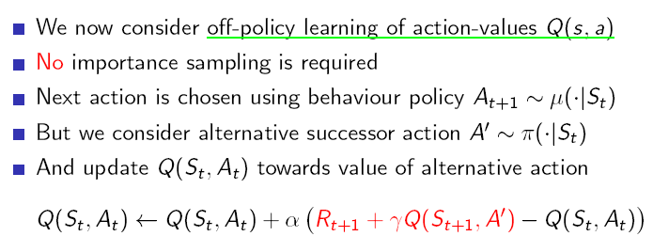
Review Lecture 5
지금까지는 on-policy
이제 off-policy → Q-learning
그니까 Q-value를 update할 때는 greedy, 움직일 때는 ε-greedy
왜 이렇게??

Slide 10
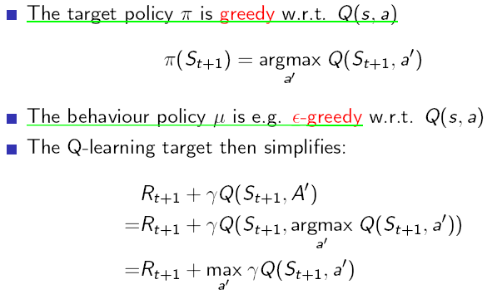
Review Lecture 5

Slide 11
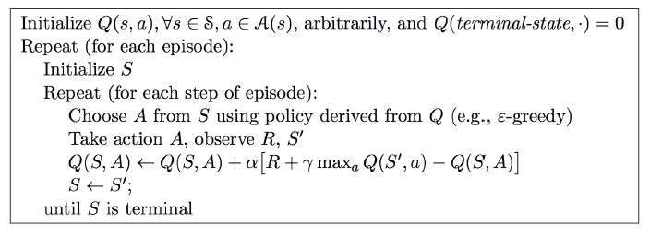
Review Lecture 5
Q-learning Argorithm

Slide 12
Review Lecture 6
But….
For Large problem? nono
For Continuous? Nono
Then how??
Function Approximation
6강 : value function approx.
7강 : policy gradient

Slide 13
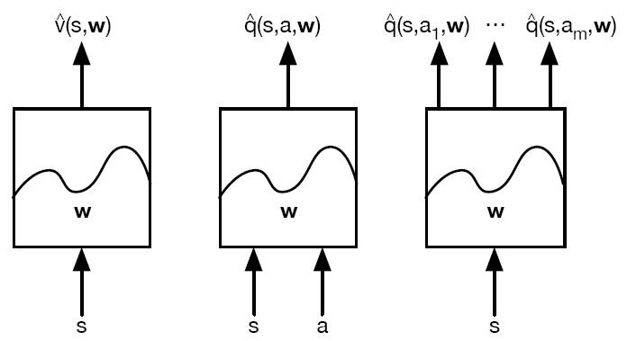
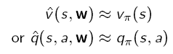
Review Lecture 6
with some weight parameter
Approximate value function
Now update w!
How??
1. incremental methods
2. batch methods

Slide 14
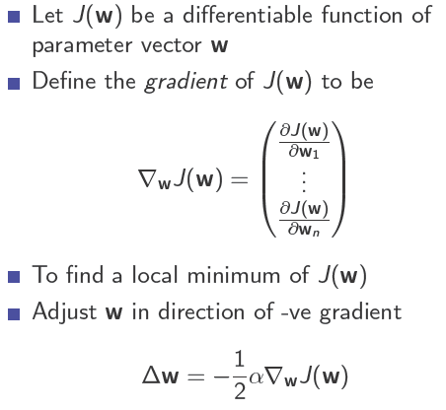
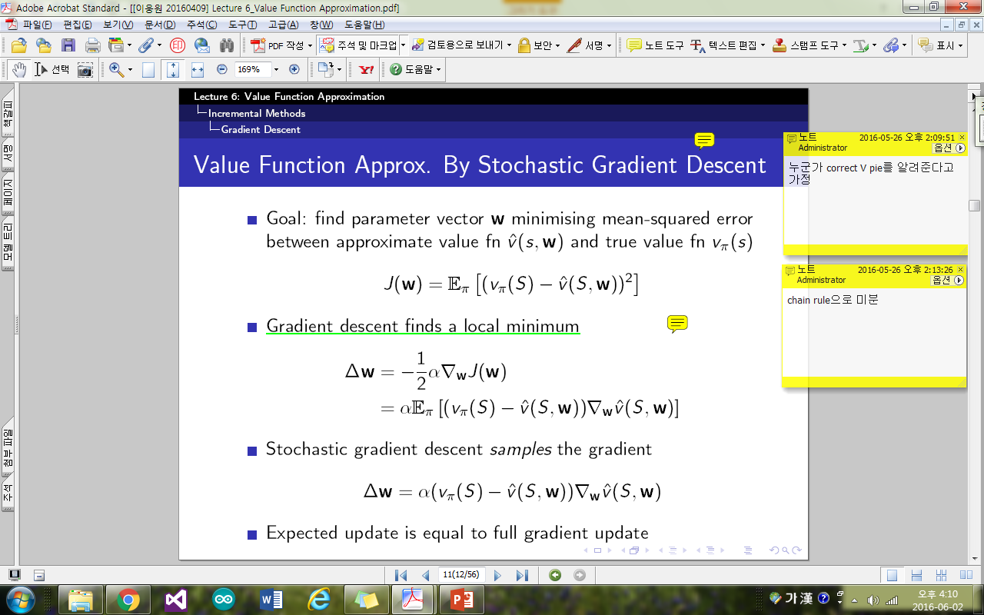
Review Lecture 6
Gradient descent!
What is J(w)?? Here, Mean squared error

Slide 15
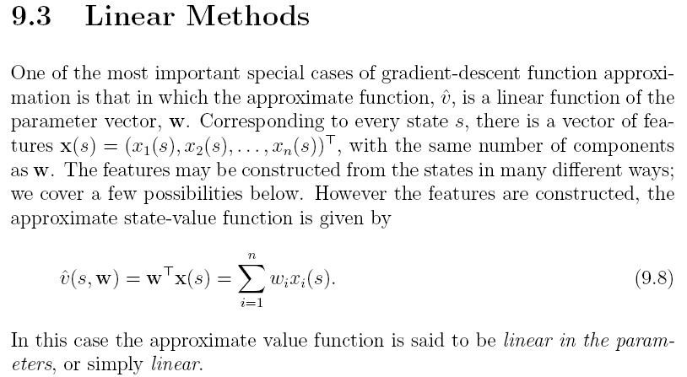
Review Lecture 6
What is feature vector?

Slide 16
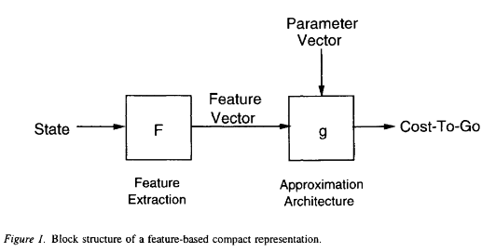
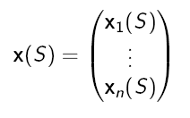
Review Lecture 6
Feature vector!
https://books.google.co.kr/books?id=URHolpWYP4oC&lpg=PA66&ots=bRrFeEWeGn&dq=reinforcement%20learning%20feature%20vector&hl=ko&pg=PA66#v=onepage&q&f=true

Slide 17
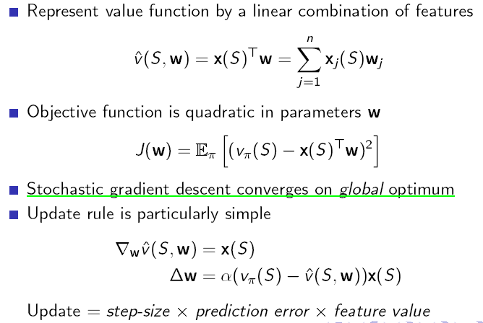
Review Lecture 6
리니어!!!!!!!!!!!

Slide 18
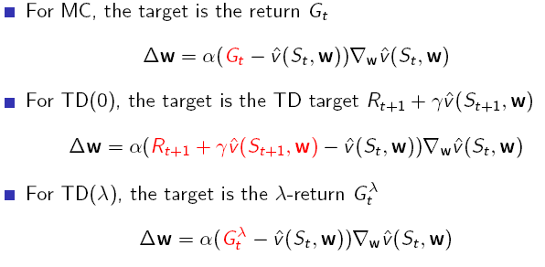
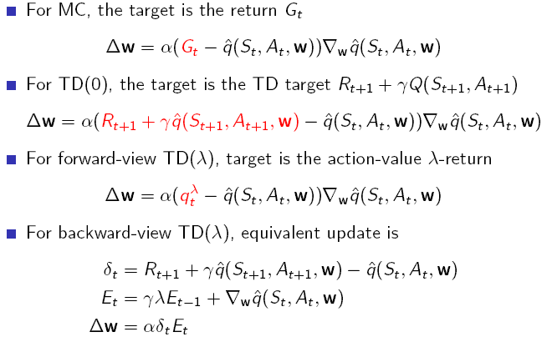
Review Lecture 6
Value function approximation Action-value function approximation

Slide 19
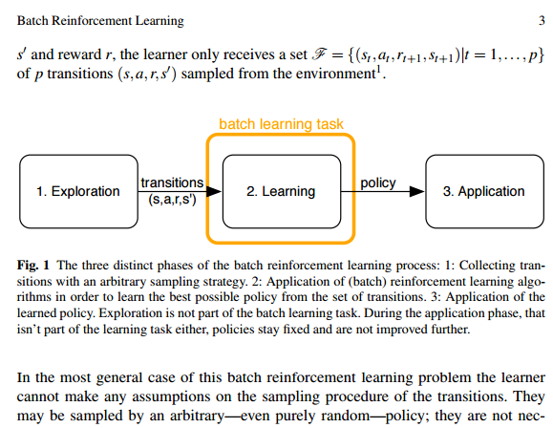
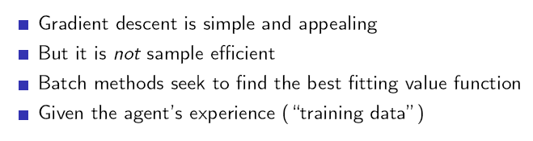
Review Lecture 6
Incremental x → batch methods?
http://ml.informatik.uni-freiburg.de/_media/publications/langegabelriedmiller2011chapter.pdf

Slide 20
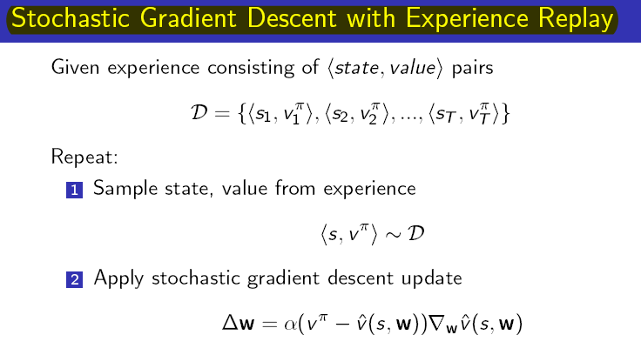
Review Lecture 6

Slide 21
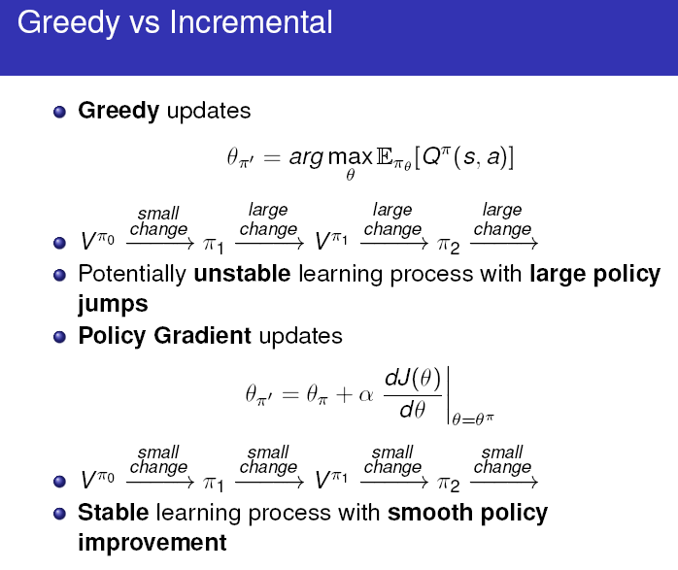
Lecture 7

Slide 22
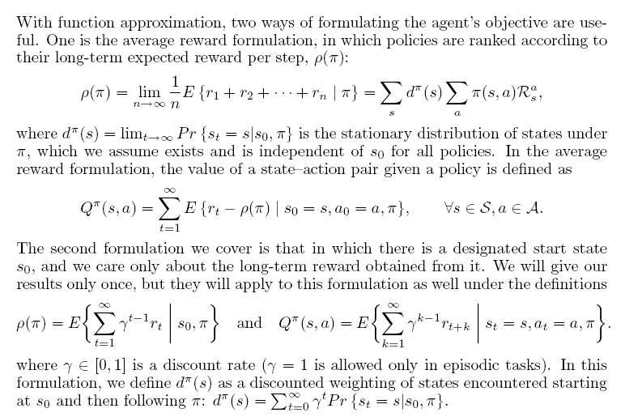
Lecture 7
Stationary distribution

Slide 23
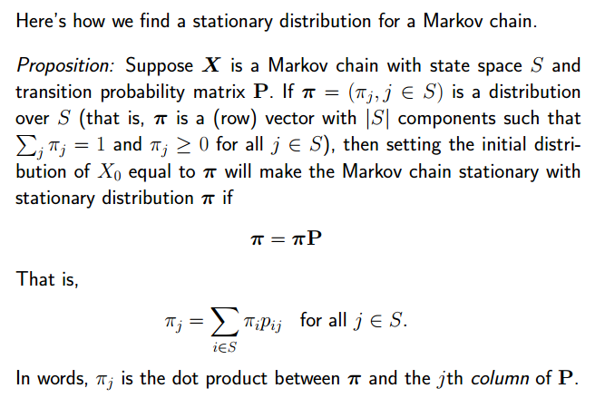
Lecture 7
Stationary distribution
Eigen value, eigen vector와의
연관성?

Slide 24
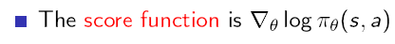

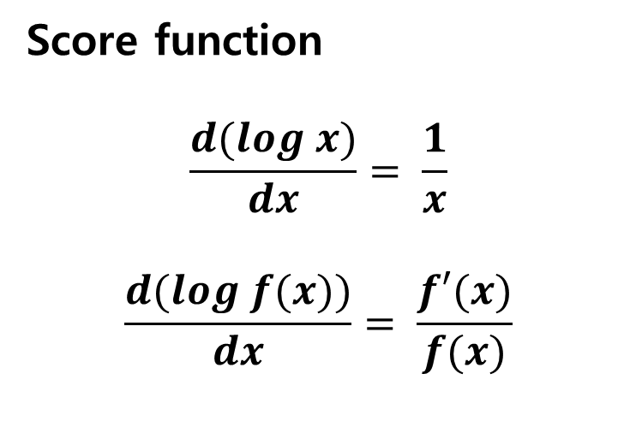
Lecture 7
Score function
$$\frac{d(log x)}{dx}= \frac{1}{x}$$
$$\frac{d(log f(x))}{dx}= \frac{f′(x)}{f(x)}$$

Slide 25
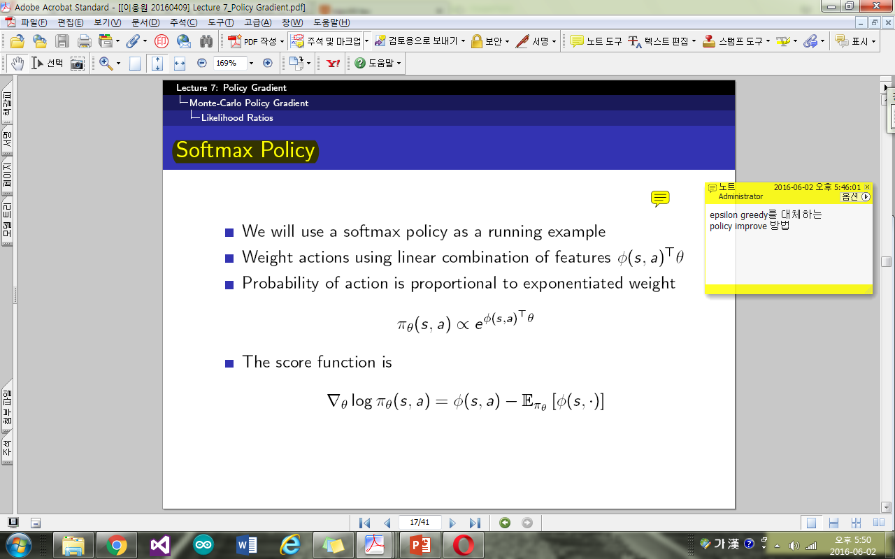
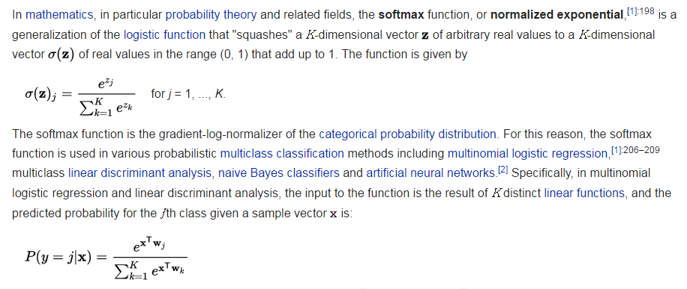
Lecture 7
Softmax policy → Gibbs distribution

Slide 26
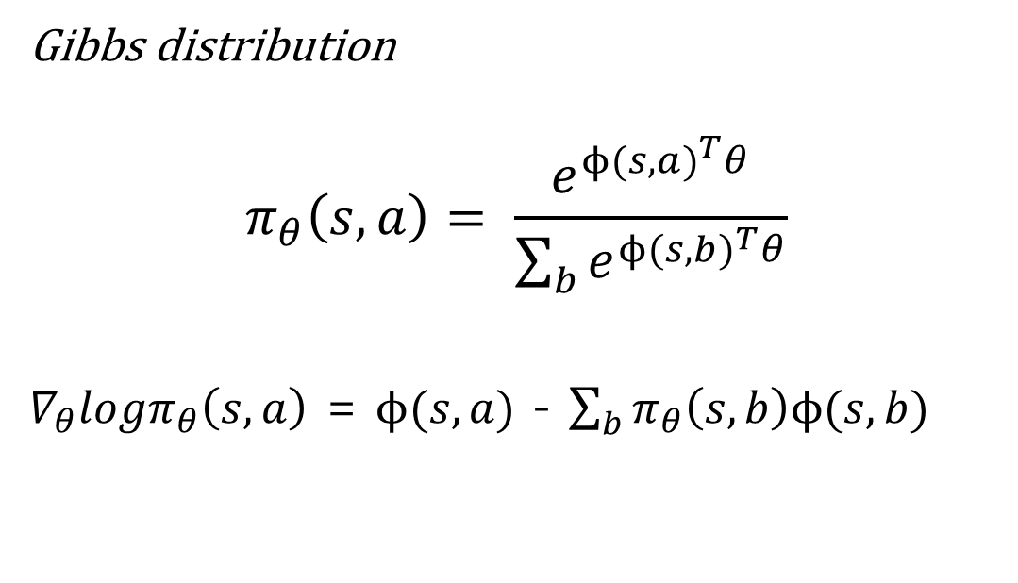
Lecture 7
Softmax policy → score function
Gibbs distribution
$$π_{θ}\left(s,a\right)= \frac{e^{{ϕ(s,a)}^{T}θ}}{\sum_{b}{e^{{ϕ(s,b)}^{T}θ}}}$$
$∇_{θ}logπ_{θ}\left(s,a\right)$ = $ϕ(s,a)$ - $\sum_{b}{π_{θ}\left(s,b\right)ϕ(s,b)}$

Slide 27
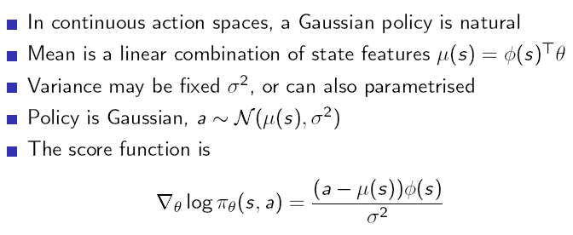
Lecture 7
Gaussian policy → score function
가우시안 분포 = 정규분포

Slide 28
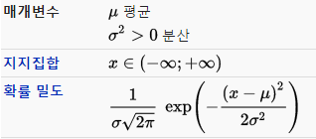
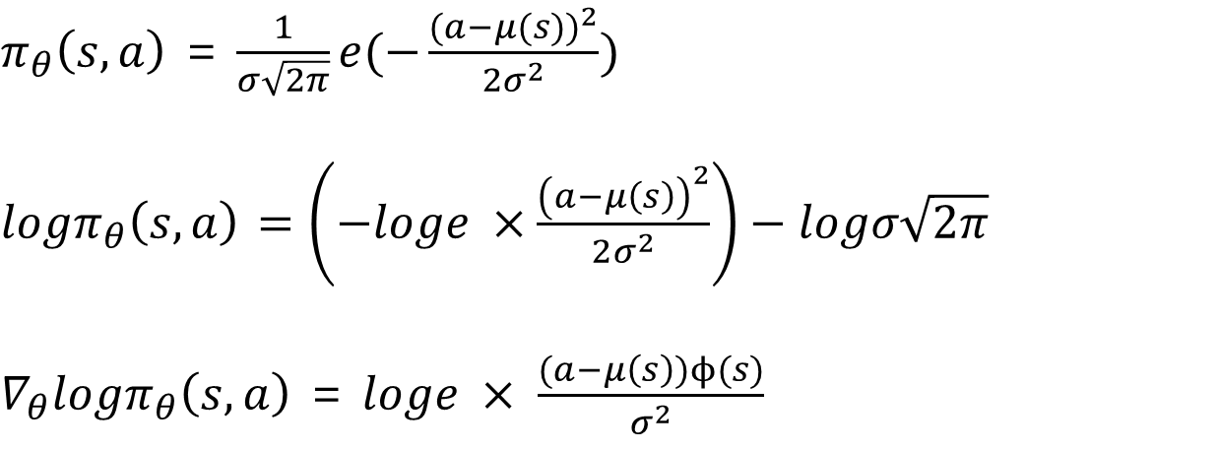
Lecture 7
Gaussian policy → score function
$π_{θ}\left(s,a\right)$ = $\frac{1}{σ\sqrt{2π}}{e(−\frac{{(a−μ(s))}^{2}}{2σ^{2}})}^{}$
$logπ_{θ}\left(s,a\right)$ $=\left(−loge ×\frac{{\left(a−μ\left(s\right)\right)}^{2}}{2σ^{2}}\right)−logσ\sqrt{2π}$
$∇_{θ}logπ_{θ}\left(s,a\right)$ = $loge × \frac{(a−μ\left(s\right))ϕ(s)}{σ^{2}}$

